Slide 1
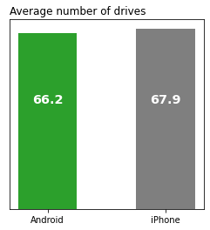
Executive summary
User Churns | two-sample Hypothesis testing results
Prepared for: Waze Leadership Team
The Waze data team is conducting a data analytics project to prevent monthly churn, and increase the overall growth of the corporation. Based on the results, Waze will be able to come up with a strategy to increase user retention.
Data team was asked to verify the suspicion whether users with Android/iPhone devices have different number of drives
The average number of drives was calculated for Android/iPhone users:
An independent t-test was conducted to test whether or not the mean of these two groups are different. The observation, showed that with 95% confidence level, there’s NO meaningful difference between means (p-value= 14%).
Due to the results rendered from this specific hypothesis test, the Waze data team recommends running additional t-tests on other variables to learn more about user behavior.
Android & iPhone users, drive with the same quantity. But via running more t-tests on these two groups, it will be clearer whether or not other behavior among them are different.

Slide 2
Title
Subtitle
Project Overview
Image Alt-Text Here

Slide 3
Title
Subtitle
Image Alt-Text Here
Image Alt-Text Here

Slide 4
Title
Subtitle
Image Alt-Text Here

Slide 5
Title
Subtitle

Slide 6
Title
Subtitle
Image Alt-Text Here

Slide 7
Title
Subtitle

